Slide 1
Emergency and Mental WellBeing
Under the guidance – Manikanta Sir

Slide 2
Introduction
The Emergency and Wellness Management System addresses the growing need for personal safety and mental well-being.
Key Features:
Emergency reporting and notifications.
Mental health assessments and tracking.
Personalized recommendations for well-being.
Access to support resources.

Slide 3
Outcomes
01
02
03
04
Efficient Emergency Management:
Mental Health Tracking:
Real-time notifications for reporting and handling emergencies.
Regular assessments with personalized recommendations.
Increased Awareness:
Comprehensive Support:
Easy access to resources for safety and well-being.
Promotes personal safety and mental well-being.

Slide 4
Modules
User Authentication and Registeration
SOS Help System
Mental Health Questionnaire and Assessment
Chatbot Support
Video Recommendation System
News API Integration
Task Management System

Slide 5
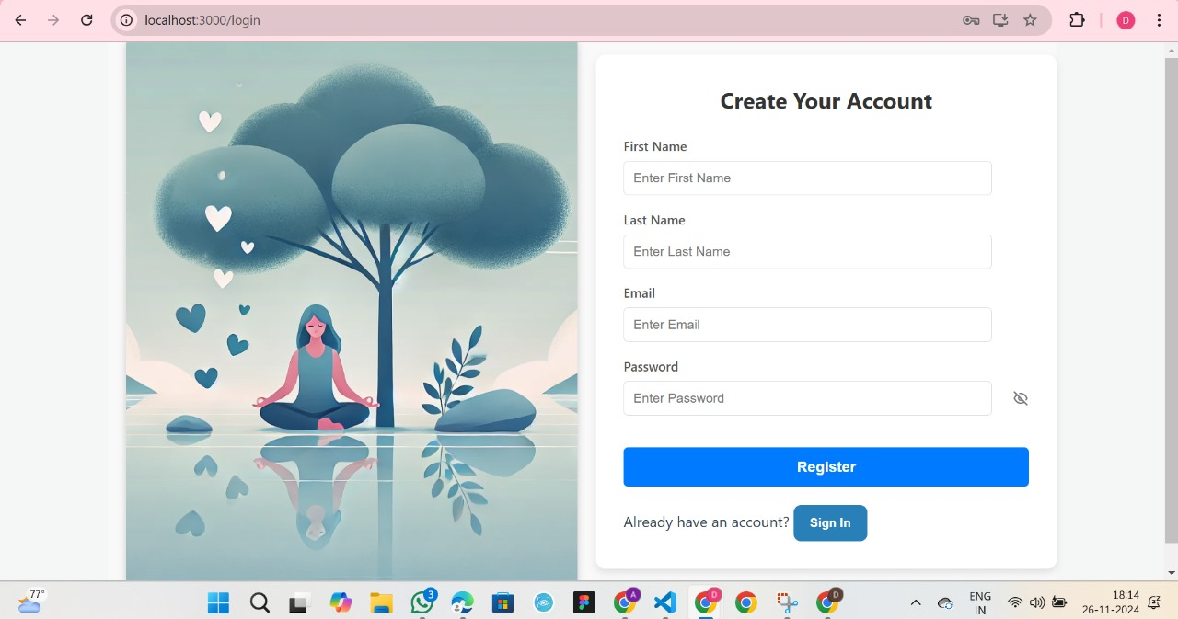
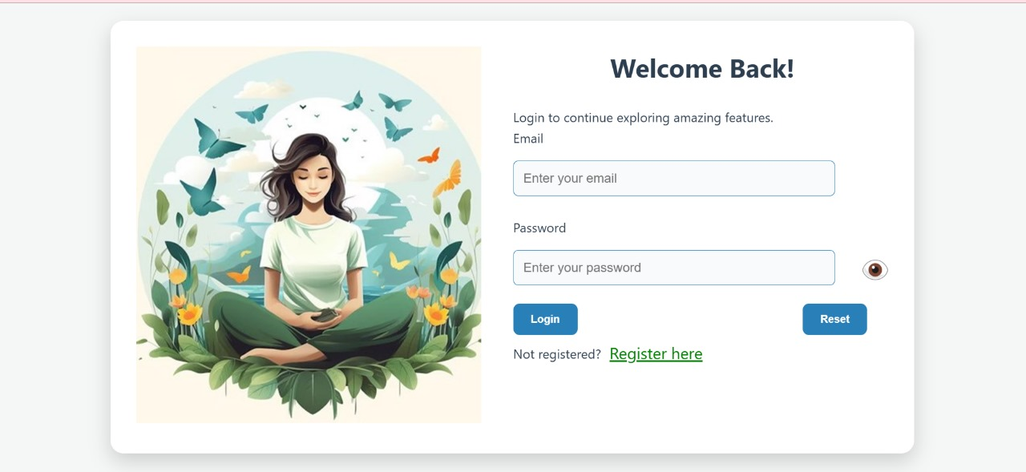
Module 1 : User Authentication and Registration
User Registration
User Login

Slide 6
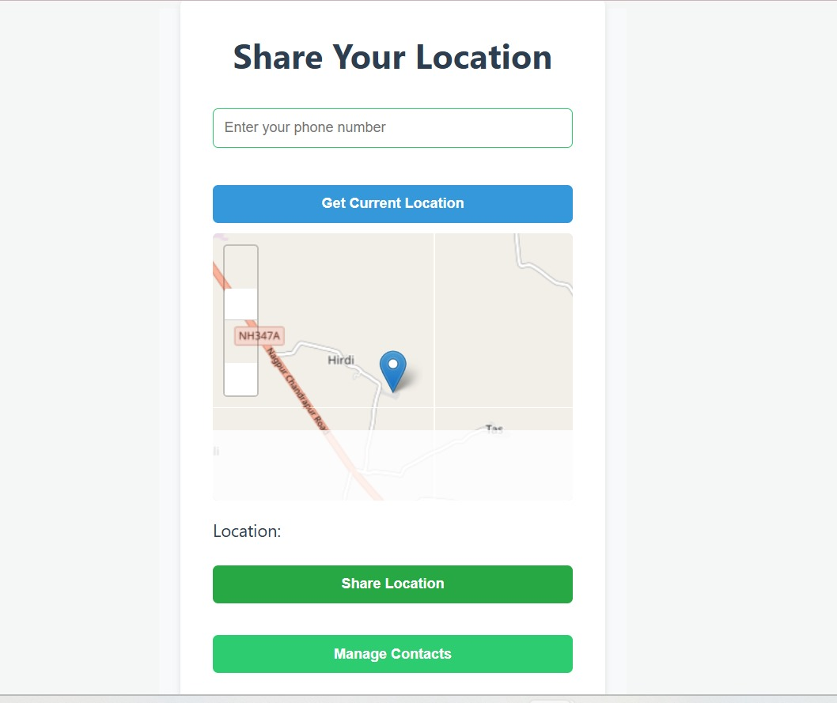
Module 2 : SOS Help System
Location sharing with pre-defined contacts.
Quick and accurate transmission.
Immediate safety assistance.

Slide 7
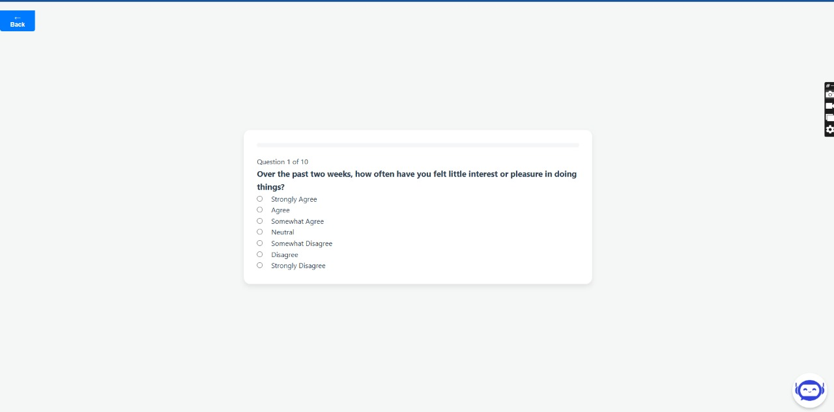
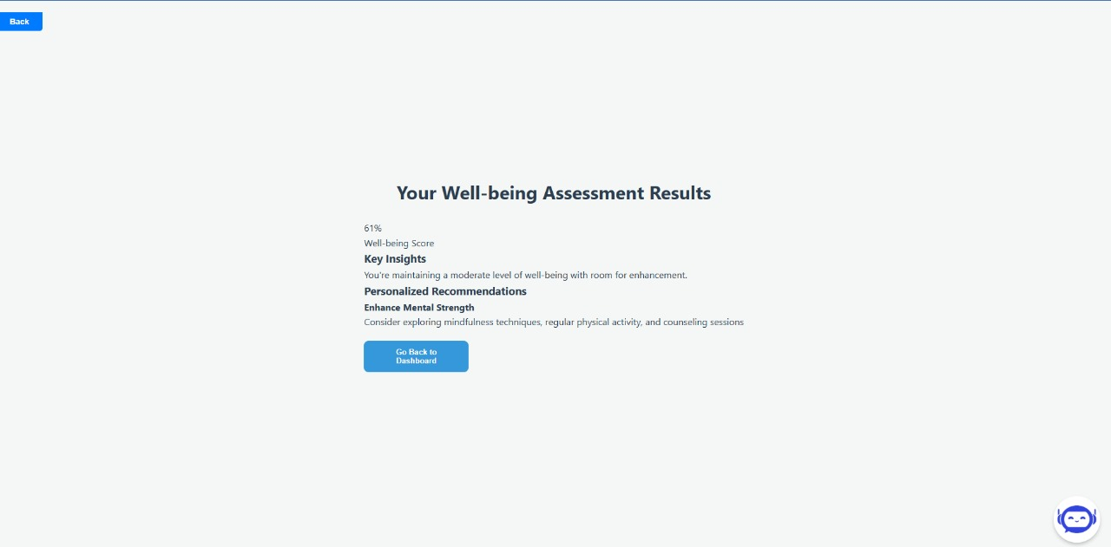
Module 3 : Mental Health Questionnaire & Assessment

Slide 8
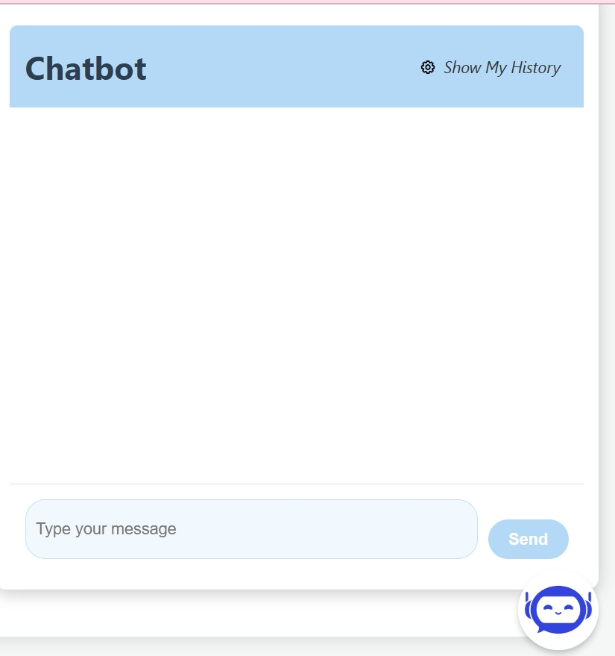
Module 4 : Chatbot Support
Real-time assistance for user queries.

Slide 9
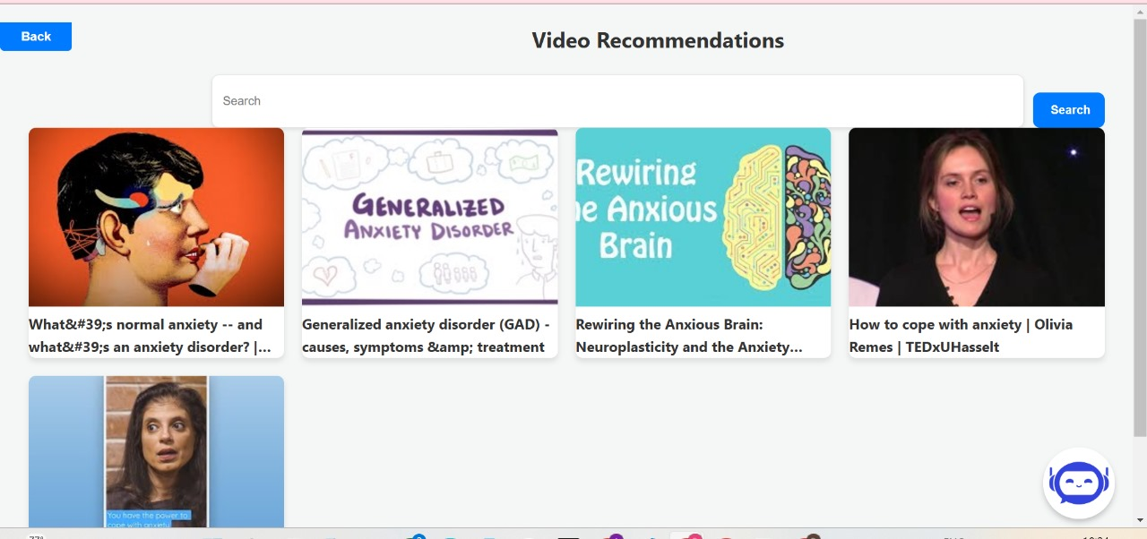
Module 5 : Video Recommendation System
Personalized video recommendations on stress, anxiety, and well-being.
Curated based on user preferences and needs.

Slide 10
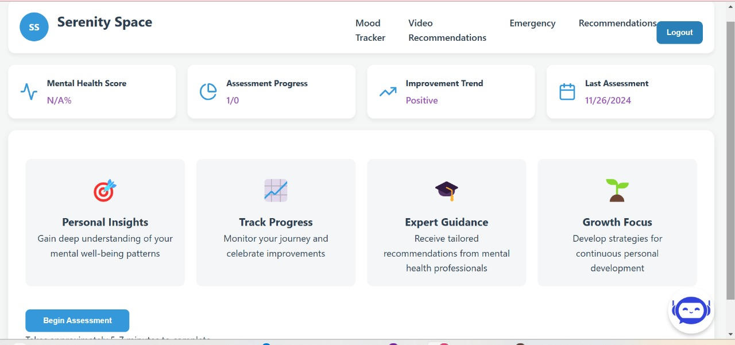
Module 6 : News API Integration
Fetches articles on emergency preparedness and health topics.
Updates users with relevant news.

Slide 11
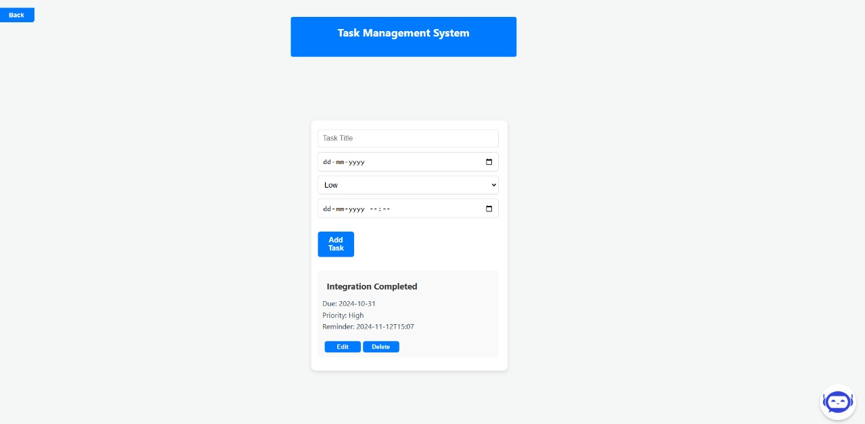
Module 7 : Task Management System
Add tasks.
Modify tasks.
Delete tasks.
Reminders.

Slide 12
Technology Stack
Frontend - React, JavaScript.
Backend - Spring Boot, Java.
Libraries - React router Dom, fetch API, Axios, React Leaflet, Lambok.
Third – party Libraries - YouTube Data API v3, Open cage API.
Database - MySQL, MongoDB.
Software & IDE - IntelliJ IDEA, VScode, Postman.
Server - Apache Tomcat.

Slide 13
Conclusion
Empowers users with real-time support and personalized resources for safety and well-being.
A comprehensive tool to manage emergencies and track mental health effectively.

Slide 14
Thank You!

